Slide 1
HISTOGRAM PROCESSING

Slide 2
HISTOGRAM PROCESSING
Basis for numerous spatial domain processing techniques
Provides useful image statistics
simple to calculate in software (+ hardware implementations)
Give information about the kind (global appearance) of
image and its properties.
Used for Image enhancement
Used for Image compression
Used for Image segmentation
Can be used for real time processing
2

Slide 3
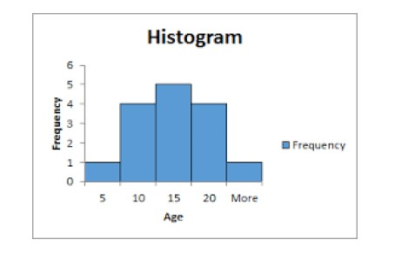
HISTOGRAM
Histogram is normally a graph where X axis represent the objects
and Y axis represent the frequency (count of objects) .
3

Slide 4
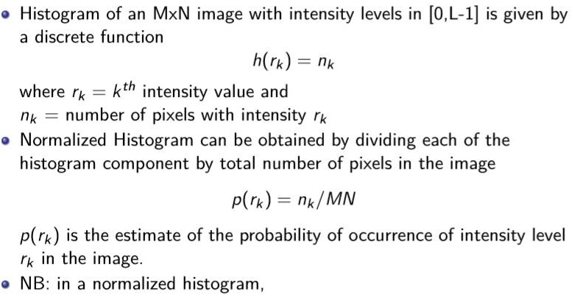

HISTOGRAM PROCESSING
4

Slide 5
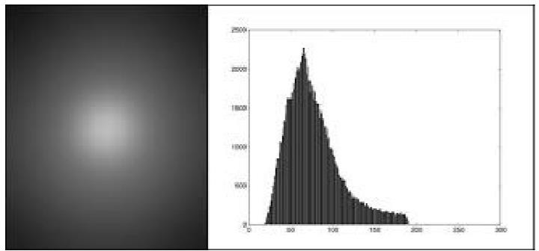
HISTOGRAM OF A SAMPLE IMAGE
5

Slide 6
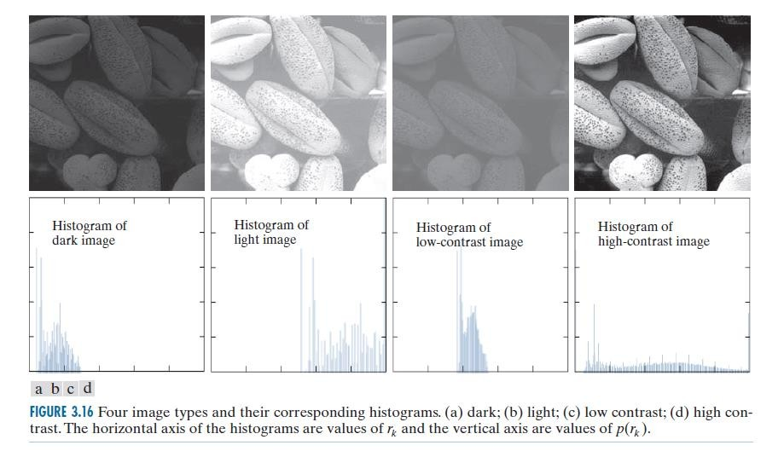
HISTOGRAM SAMPLE
6

Slide 7
HISTOGRAM SAMPLE (INTERPRETATION)
In the dark image that the most populated histogram bins are
concentrated on the lower (dark) end of the intensity scale.
Similarly, the most populated bins of the light image are biased toward the higher end of the scale.
An image with low contrast has a narrow histogram located typically toward the middle of the intensity scale shows.
For a monochrome image, this implies a dull, washed-out gray look.
The components of the histogram of the high-contrast image cover a wide range
7

Slide 8
HISTOGRAM EQUALIZATION
Histogram equalization
is a image
enhancement technique in which we enhance the image contrast by stretching the image histogram.
8

Slide 9
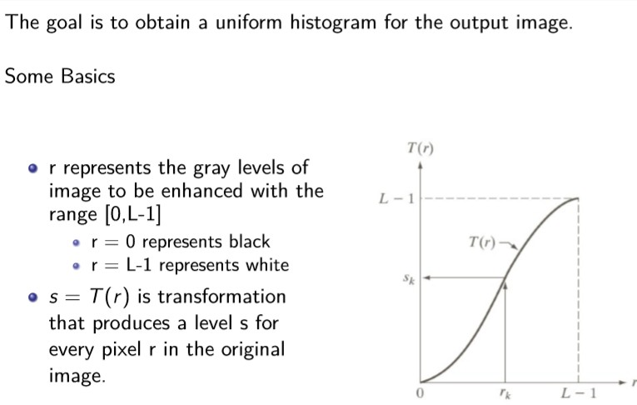
HISTOGRAM EQUALIZATION
9

Slide 10
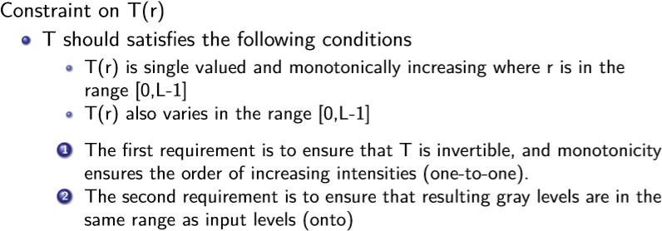
HISTOGRAM EQUALIZATION
10

Slide 11
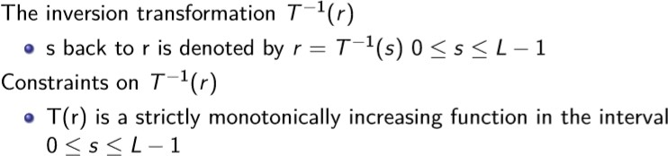
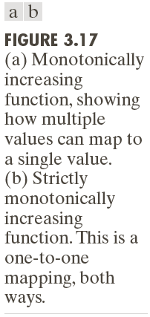
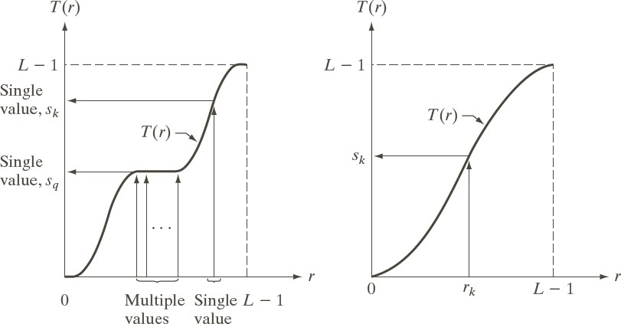
HISTOGRAM EQUALIZATION
11

Slide 12
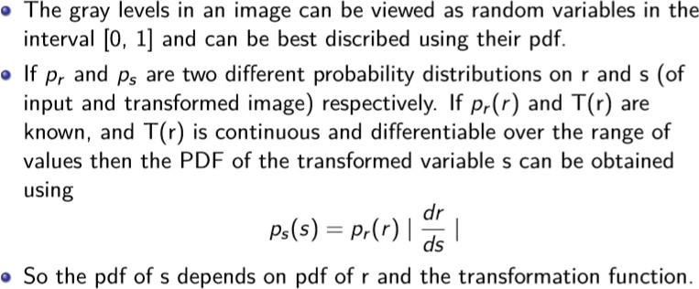
HISTOGRAM EQUALIZATION: CONTINUOUS CASE
PDF- PROBABILITY DENSITY FUCNTION
CDF- CUMULATIVE DISTRIBUTION FUNCTION
12

Slide 13
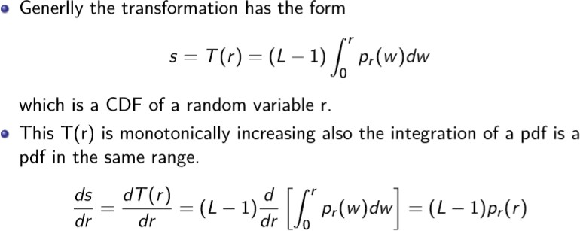
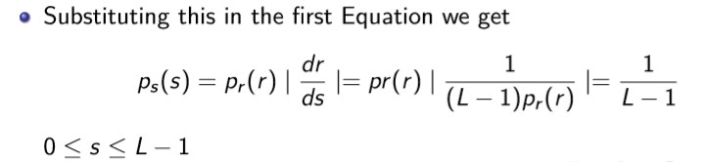
HISTOGRAM EQUALIZATION: CONTINUOUS CASE
13

Slide 14
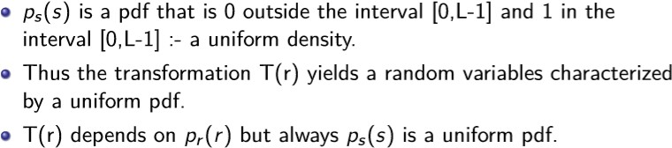
HISTOGRAM EQUALIZATION: CONTINUOUS CASE
14

Slide 15
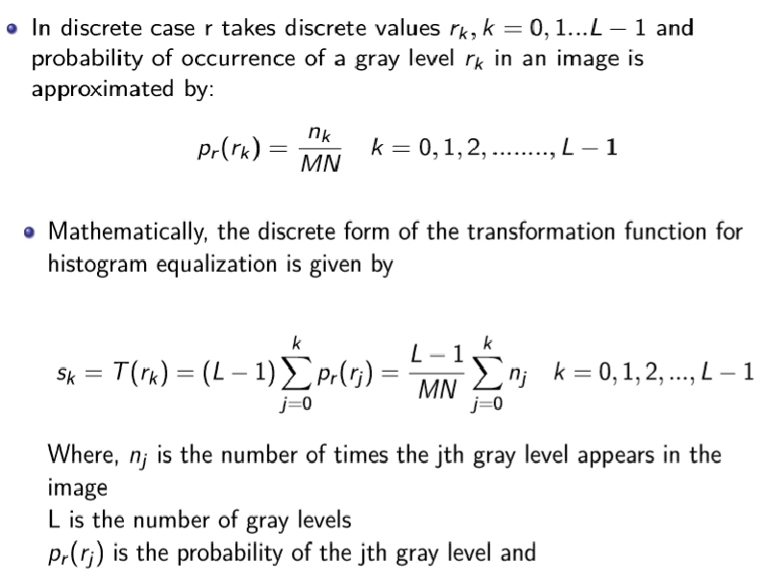
HISTOGRAM EQUALIZATION: DISCRETE
15

Slide 16
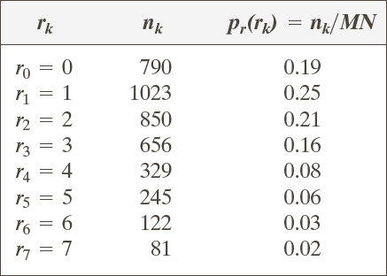
EXAMPLE: HISTOGRAM EQUALIZATION
Suppose that a 3-bit image (L=8) of size 64 × 64 pixels (MN = 4096) has the intensity distribution shown in following table.
Get the histogram equalization transformation function and give the p_{s}(s_{k}) for each s_{k}.

Slide 17
EXAMPLE: HISTOGRAM EQUALIZATION
s₀ = T (r₀ ) = 7∑ p_{r} (r_{j} ) = 7 × 0.19 = 1.33
j =0
s₁ = T (r₁ ) = 7∑ p_{r} (r_{j} ) = 7 ×(0.19 + 0.25) = 3.08
0
→1
→ 3
1
j =0
s₂ = 4.55 → 5
s₄ = 6.23 → 6
s₆ = 6.86 → 7
s₃ = 5.67 → 6
s₅ = 6.65 → 7
s₇ = 7.00 → 7

Slide 18
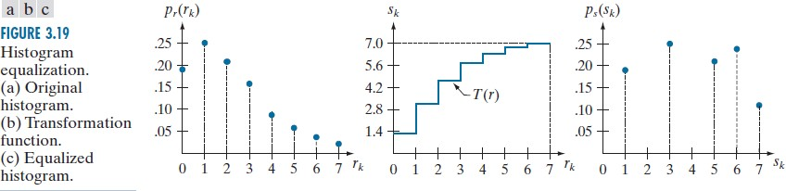
EXAMPLE: HISTOGRAM EQUALIZATION

Slide 19
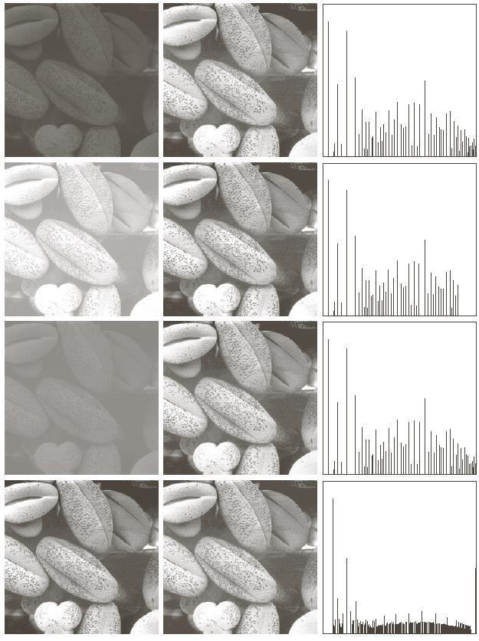
HISTOGRAM EQUALIZED IMAGE
19

Slide 20
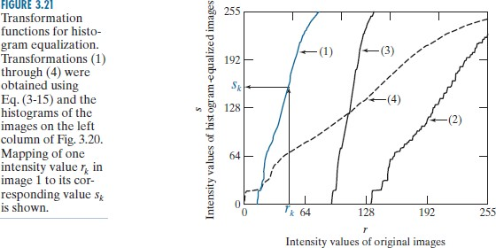
HISTOGRAM EQUALIZED IMAGE - TRANSFORMATION FUNCTION
20

Slide 21
DISCLAIMER
The material for the presentation has been compiled from various sources such as prescribed text book by Rafael C. Gonzalez and team, tutorials, lecture notes and other resources available on internet. The information contained in this lecture/ presentation is for educational purpose only.
21

Slide 22
THANK YOU
22

